Slide 1
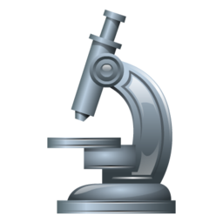
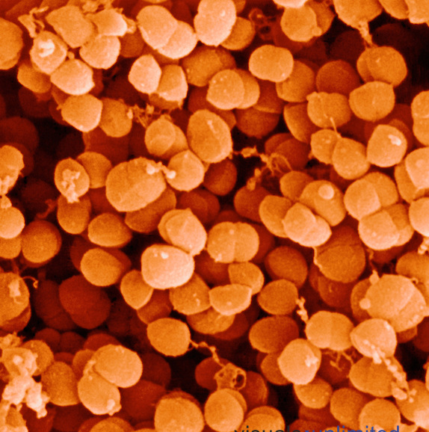
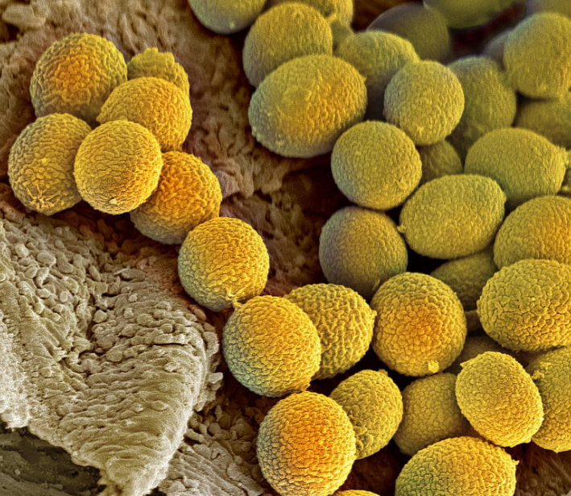
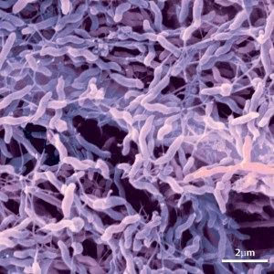
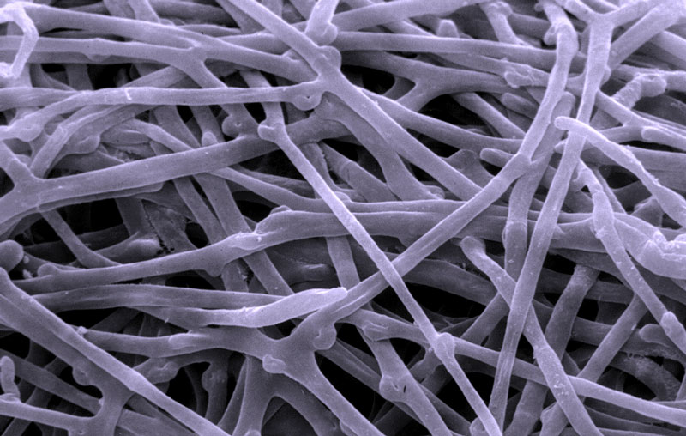
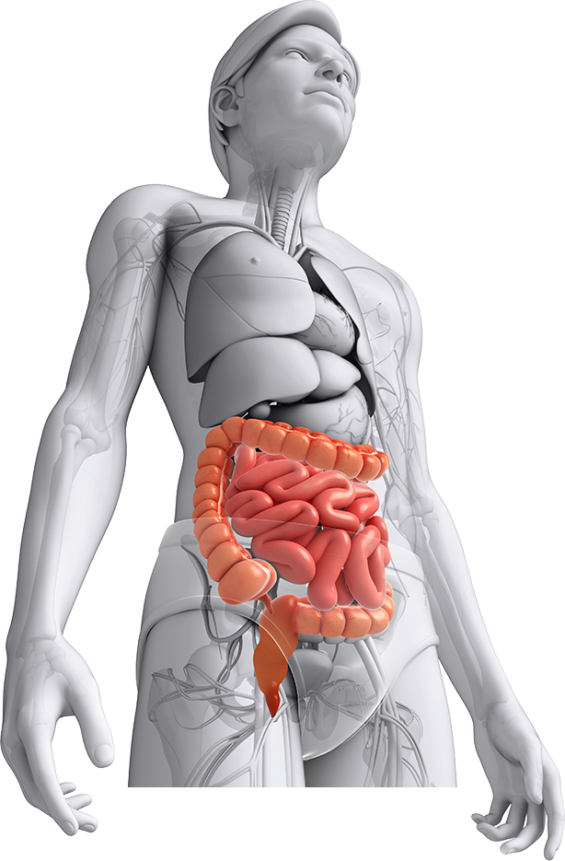
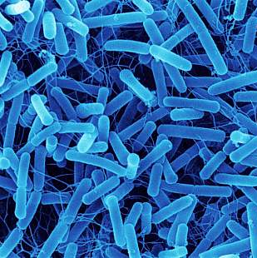
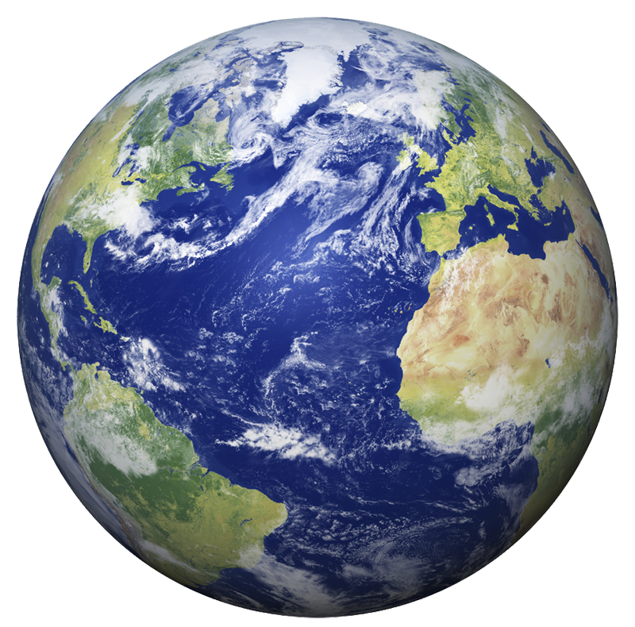
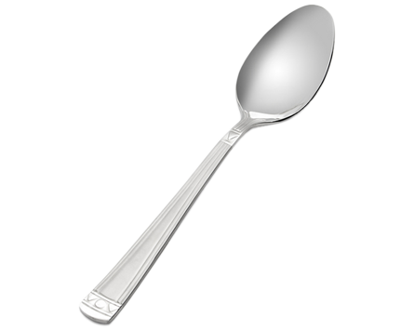
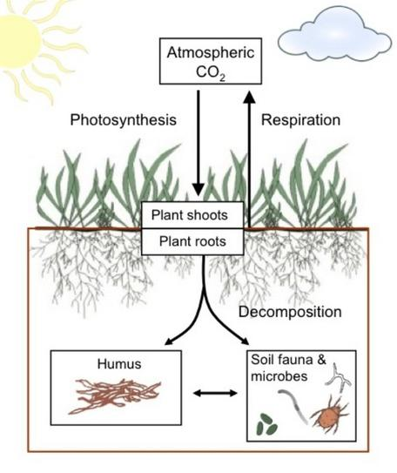
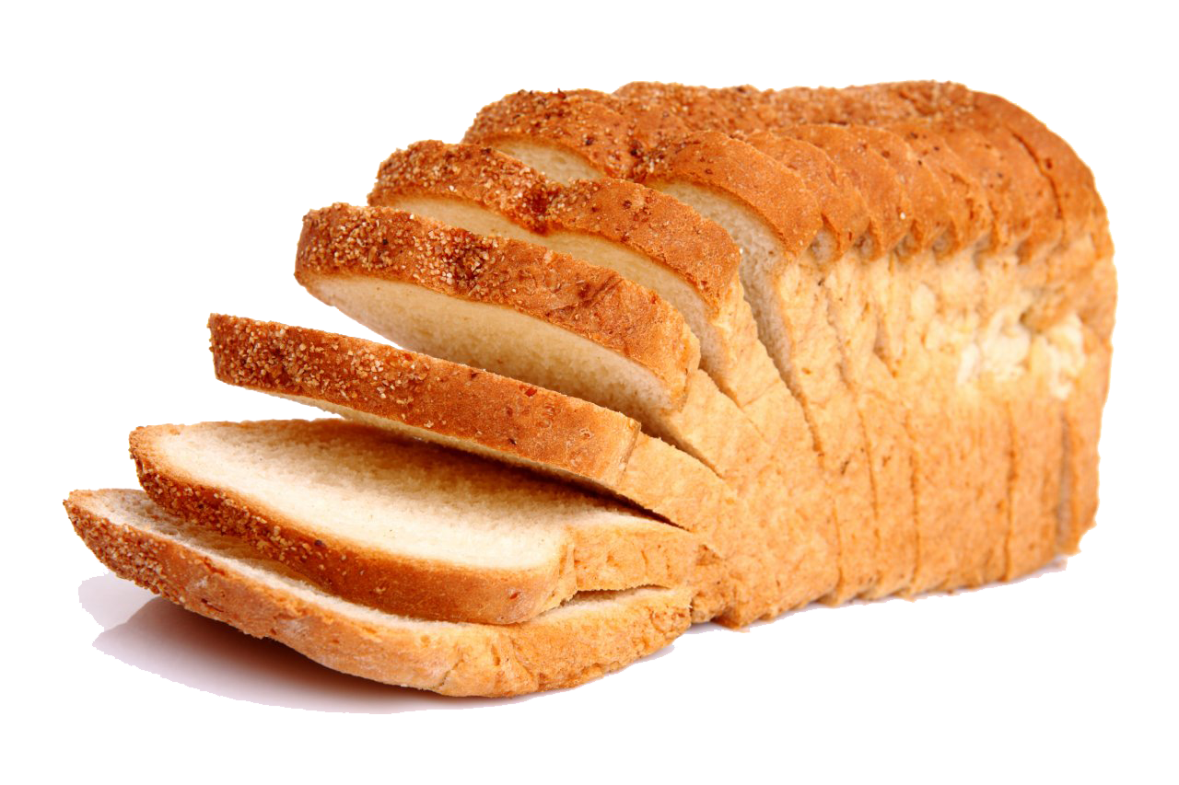
PLANT, SOIL
& MICROBIAL
SCIENCES DEPARTMENT
MICHIGAN STATE
UNIVERSITY
Unseen Organisms: How Scientists Measure the “Breath” of Microscopic Life
What are microbes?
How can we measure microbial breath?
Microbes are organisms too small to see with the naked eye: less than 1/25000 of an inch! Bacteria and fungi are common types of microbes.
CO₂
CH₄
N₂O
H₂O
Cocci
fungal spores
2
Air from the chamber is pumped to the Infrared Gas Analyzer (IRGA)
The IRGA measures which wavelengths of light are absorbed by infrared light in order to estimate GHG concentrations
We calculate respiration as a rate: change in gas conc. / change in time
(spherical bacteria)
3
1
As soil microbes respire, greenhouse gases (GHGs) accumulate in the chamber. GHGs like methane and CO₂ absorb solar radiation and contribute to global warming.
fungal hyphae
4
Spirilla
(spiral bacteria)
(rod bacteria)
Bacilli
Where are microbes found?
Soils – a single teaspoon of healthy soil contains 1 billion microbes. For reference, the human population on earth is 7 billion.
7 billion people
How do microbes breathe?
Many microbes breathe similarly to you and me, by taking in oxygen and releasing carbon dioxide (CO₂). These are called aerobic microbes.
O₂
CO₂
1 billion microbes
Human microbiome – your body contains more microbial cells than human cells; gut microbes are essential to digest food
Extreme environments – including hot springs, caves, ice, clouds, and the deep ocean!
Some microbes are able to respire even when oxygen is not present. These microbes are anaerobic. Some microbes even breathe metals like iron!
Useful products -- fuels and antibiotics are derived from microbes.
NO₃
N₂O
Food – some of your favorite foods like beer, yogurt, cheese, and bread are made with help from microbes.

